Slide 1
Funding gaps to realize the Global Plan to End TB
Suvanand Sahu
Stop TB Partnership
TB2018, Amsterdam
22 July 2018

Slide 2
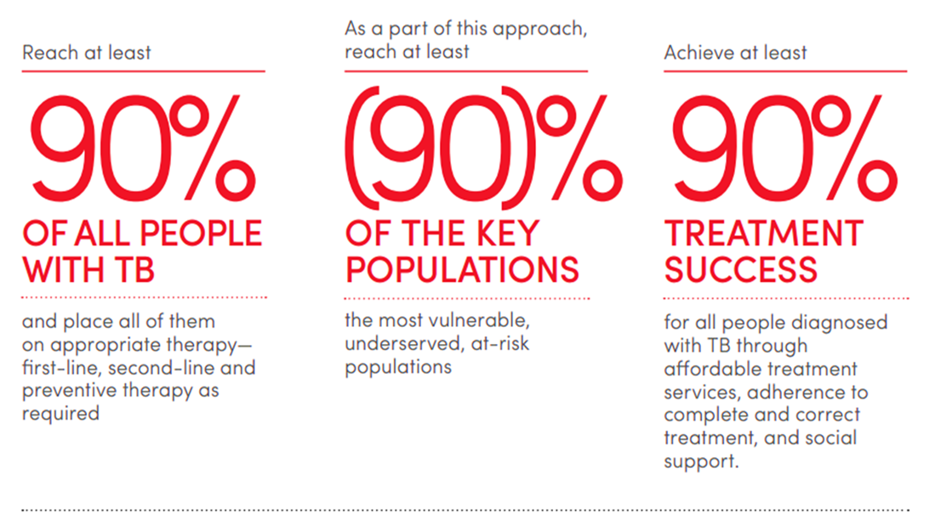
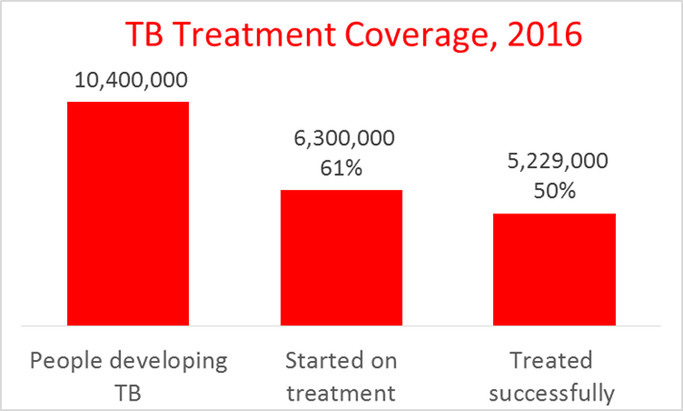
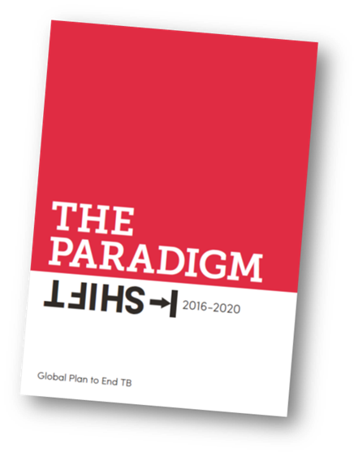
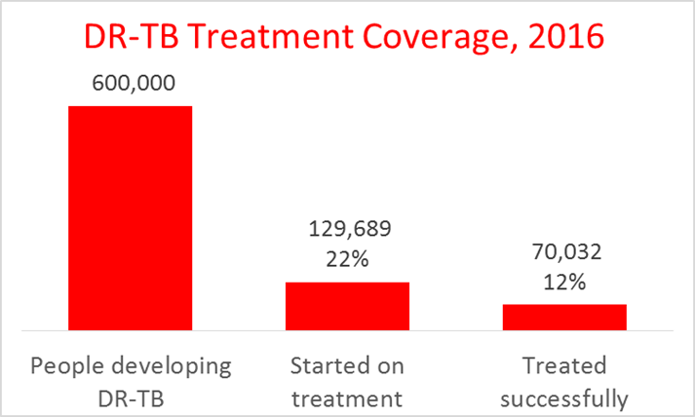
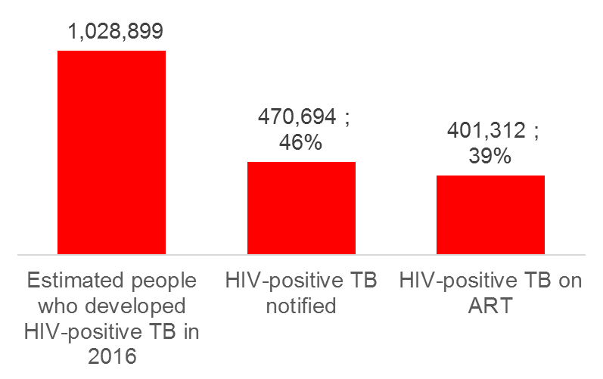
Global Plan: “Paradigm shift needed”

Slide 3
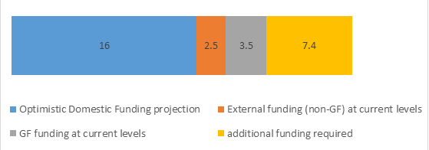
Resource needs in the Global Plan to End TB: 2016-2020
During 2016-2020, a total of 65 billion investment required:
USD 56 billion needed to implement TB programmes
USD 9 billion to fund R&D for new tools.
Resource needs (in US$ billions) for Global Fund eligible countries for the period 2016–2020 (Total US$29.4 billion), by source of expected funding

Slide 4
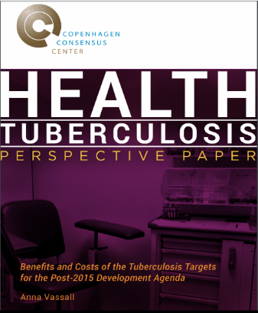
Return on investment
Global Plan: accelerated investment scenario:
29 million treated for TB
45 million TB cases prevented
10 million lives saved
Copenhagen Consensus:
“1 USD invested in TB gives 11 to 192 USD back”
“we estimate that the current Benefit-to-Cost Ratio (BCR) for the diagnosis and treatment of TB is likely to be somewhere in the range 11-192: 1 depending on the value of a DALY used. For countries adopting intensified case detection and treatment of latent TB for those living with HIV, the additional investment has a BCR of 6-47:1. For countries diagnosing and treating MDR-TB, the extra investment has a BCR of 0-5:1. “

Slide 5
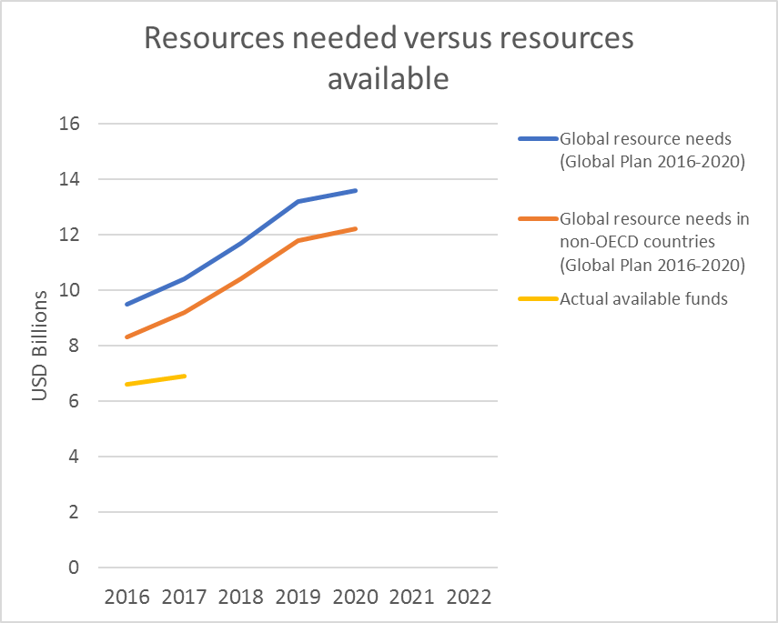
FOR IMPLEMENTATION (excluding R&D)
Resource availability falls far short of the need expressed in the Global Plan 2016-2020.
Out of the 6.9 billion USD available in 2017, 80% is domestic funding.
In LICs only 13% is domestic
In LMIC about 50% domestic
80% of international funding is from Global Fund.

Slide 6
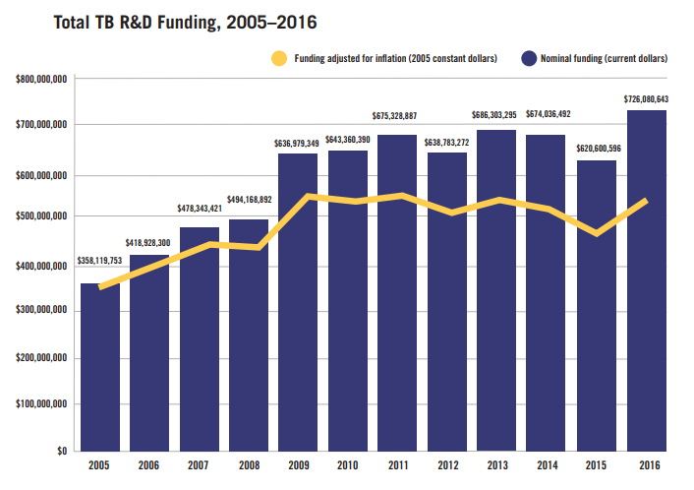
R&D funding increased marginally in 2017 but needs to triple

Slide 7
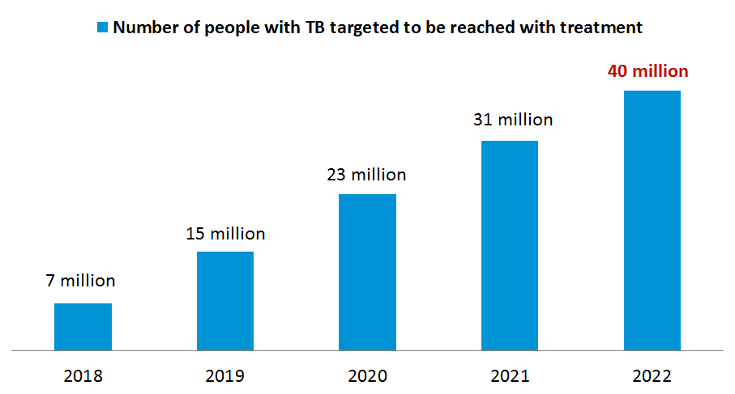
Updated targets
FIND. TREAT. ALL. #ENDTB
Joint Initiative of the World Health Organization, Stop TB Partnership, the Global Fund,
countries and partners
Between 2018 - 2022:
At least 40 million people with TB reached with care, including 3.5 million children and 1.5 million people with drug-resistant TB

Slide 8
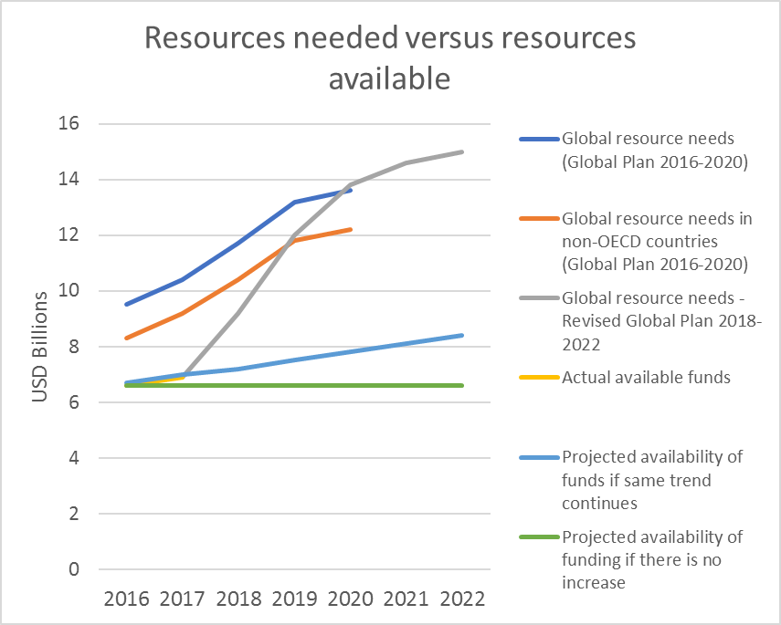
FOR IMPLEMENTATION (excluding R&D)
Updated resource needs
Revised Global Plan estimates:
13 billion USD per annum average need for the period 2018-2022
Gap
Current levels of funding (6-7 billion USD per annum) need to be doubled to meet the resource needs

Slide 9
Resource needs updated up to 2022
For Implementation
During 2018-2022, 65 billion USD will be needed with an average annual need of 13 billion USD
Current funding needs to double
For Research and Development
Annual funding is about 0.7 billion USD with a gap of 1.3 billion USD per annum
Current funding needs to be tripled

Slide 10
How do we meet the resource needs for TB
Increase domestic funding
Increase external funding
Other sources of funding: Innovative funding mechanisms, loans, bonds, insurance, private sector resources, etc.
Smart investments and efficiency gains
HIV budgets should fund TB-related care for PLHIV
ART for co-infected
TB case finding among PLHIV
Preventive TB therapy for PLHIV

Slide 11
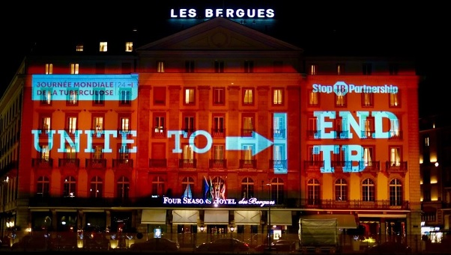
Thank you

